Slide 1


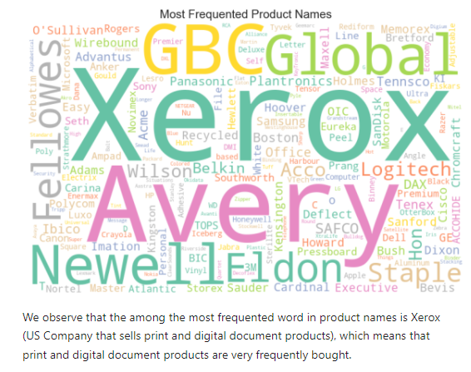
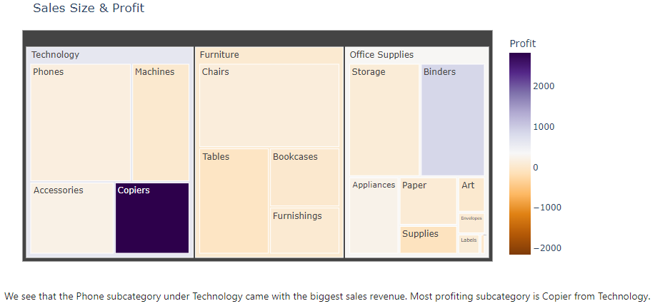
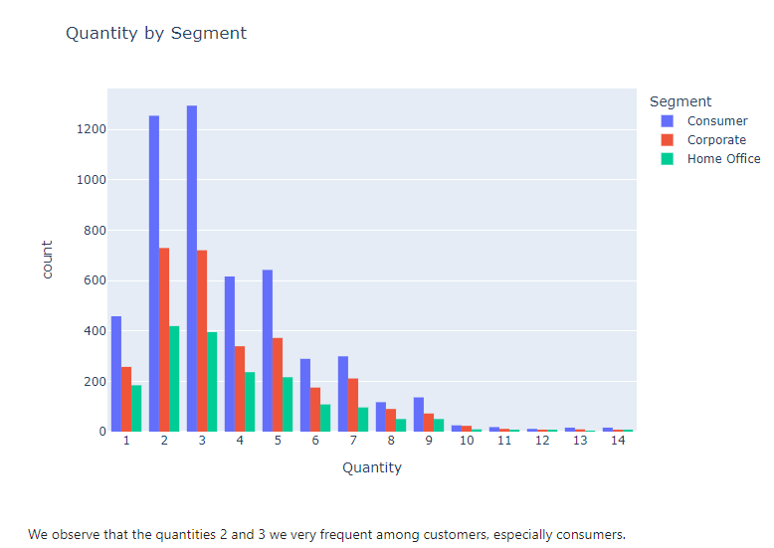
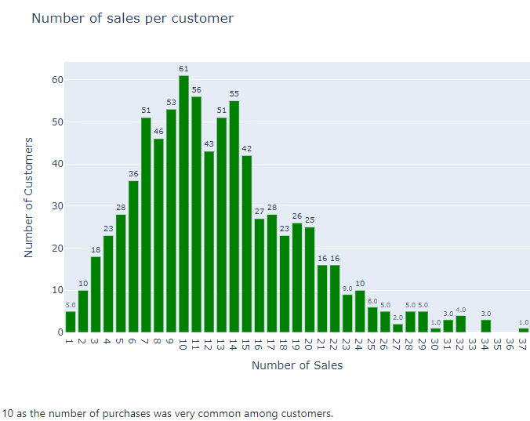
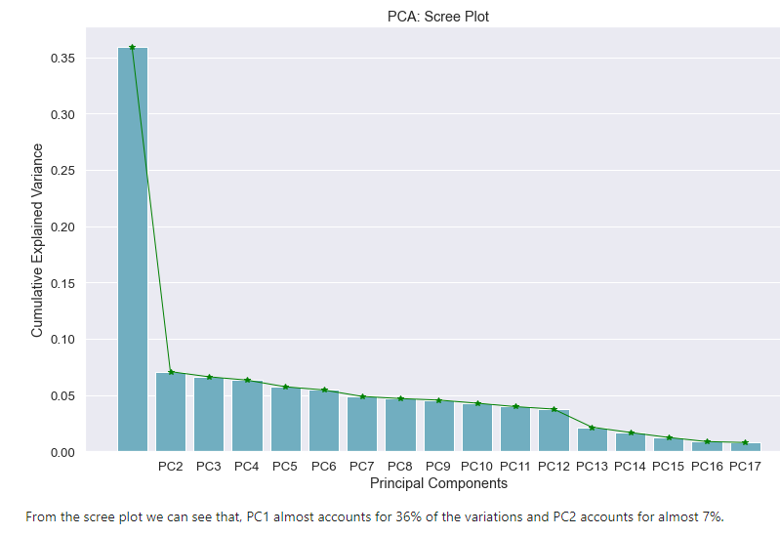
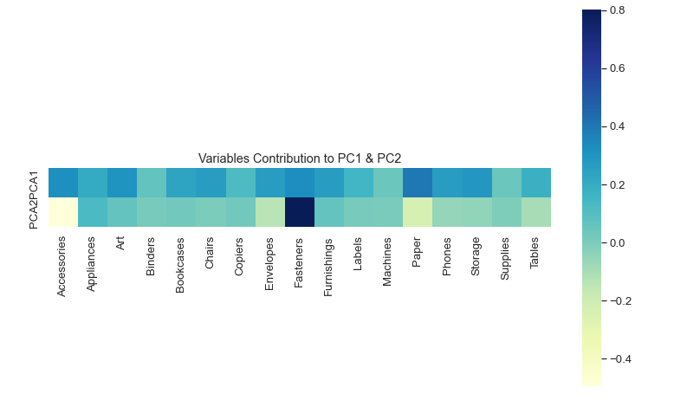
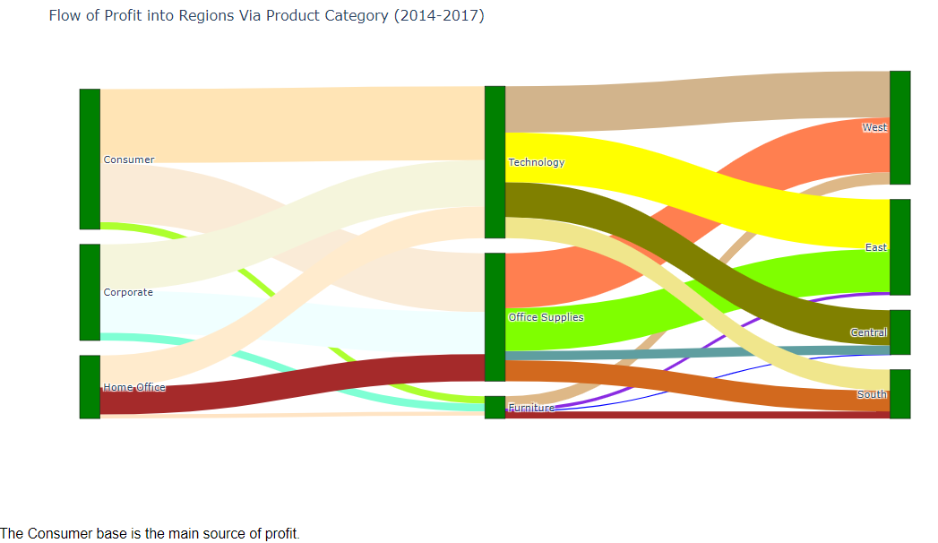
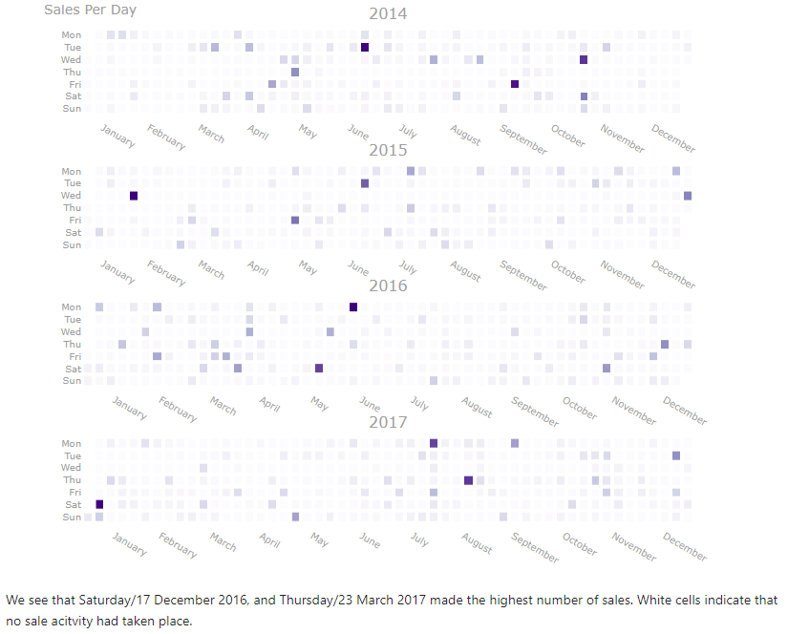
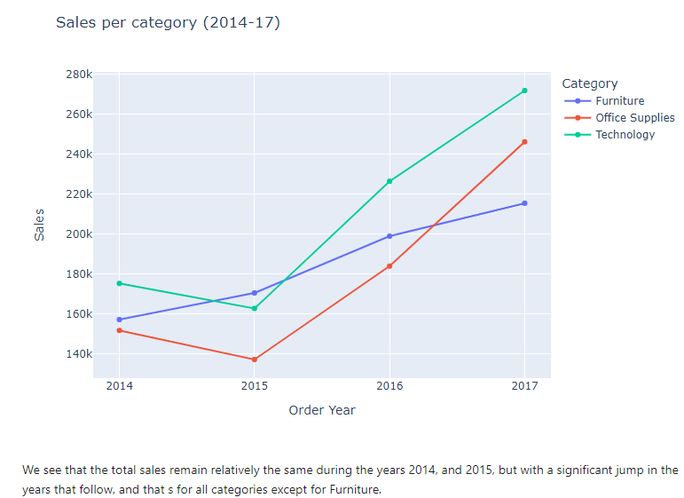
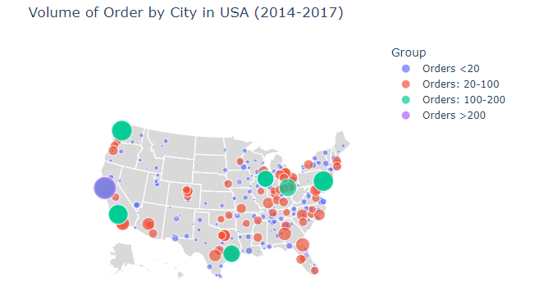
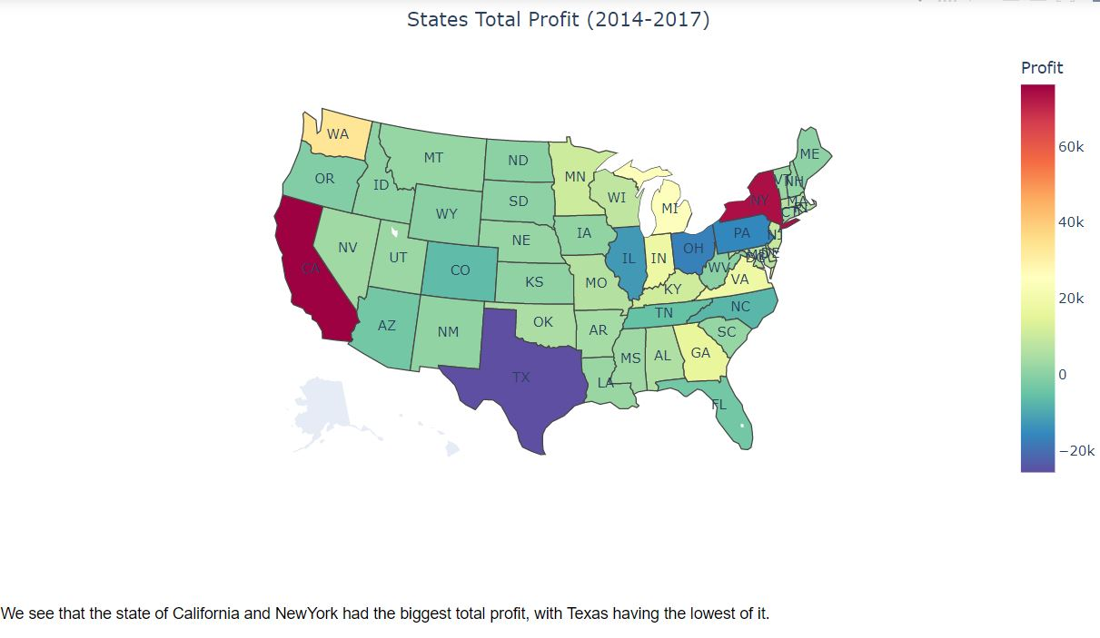
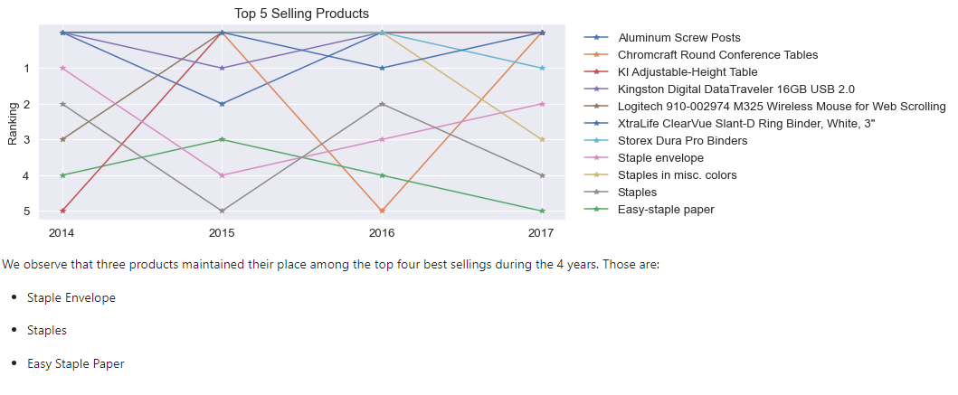
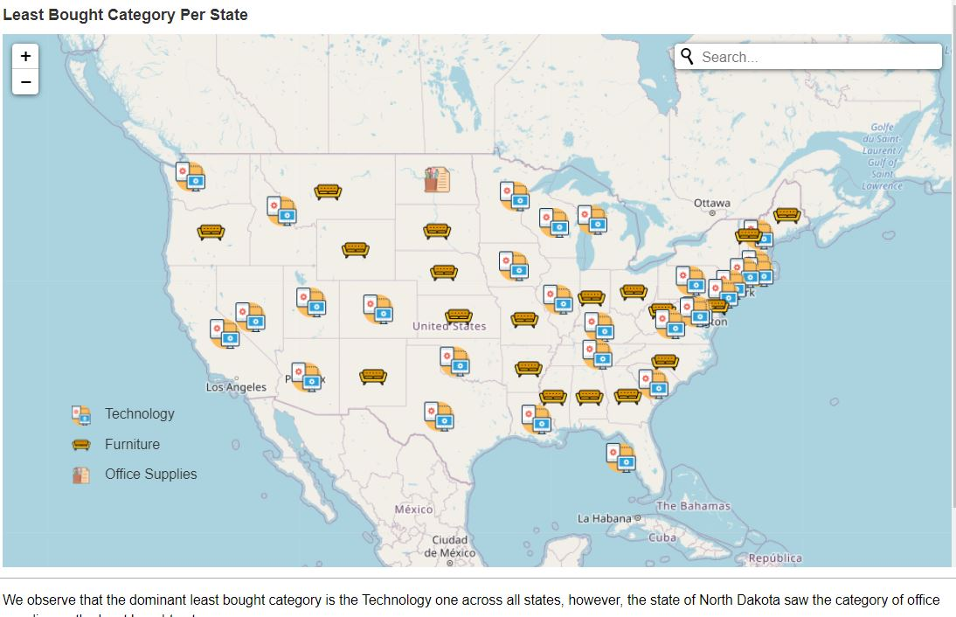
Superstore Sales & Profit Analysis
(USA, CANADA)
Mohamed AL JALANJI, Chorouk MOUSSAOUI, Ali FATOORIFAR, Samy AIT MOHAMMED
LIPN-CNRS, UMR 7030, Université Paris 13, 99, Avenue J-B. Clément, 93430 Villetaneuse, France
Objective
        ► Product Analysis
        ► Customer Analysis
        ► Time Series Analysis
        ► Location Analysis
Product Analysis
Customer Analysis
Time Series Analysis
Location Analysis
Conclusion
► Product Analysis: Print documents were frequently bought. Biggest sales revenue and profit came from phones and copiers, respectively.
► Customer Analysis: Consumers are the main source of profit. Consumers make more often 10 purchases, with preferred quantity 2.
► Time Series Analysis: Furniture had no sales fluctuations across the years. The ship mode First Class was linked with the highest profit.
► Location Analysis: California&NY had the biggest profit, but only CA for orders volume. North Dakota had the least office items sales.

